Slide 1

Designing of IoT Solutions
IoT Physical Servers & Data Analytics for IoT
IoT
Charanraj B R
Department of Computer Science Engineering

Slide 2

Designing of Iot solutions
IoT Physical Servers & Data Analytics for IoT
Charanraj B R
Department of Computer Science Engineering

Slide 3
Designing of IoT Solution
Outline of Presentation
Software & Management Tools for IoT

Slide 4
Designing of IoT Solution
Software & Management Tools for IoT
DeviceHive
Kaa
Arduino
Home Assistant
Devicehub.net
Node-Red

Slide 5
Designing of IoT Solution
Software & Management Tools for IoT
DeviceHive
DeviceHive is an Alliance member
open source (M2M) framework was launched in 2012
Its cloud-based API
Potential applications are security, smart home technology

Slide 6
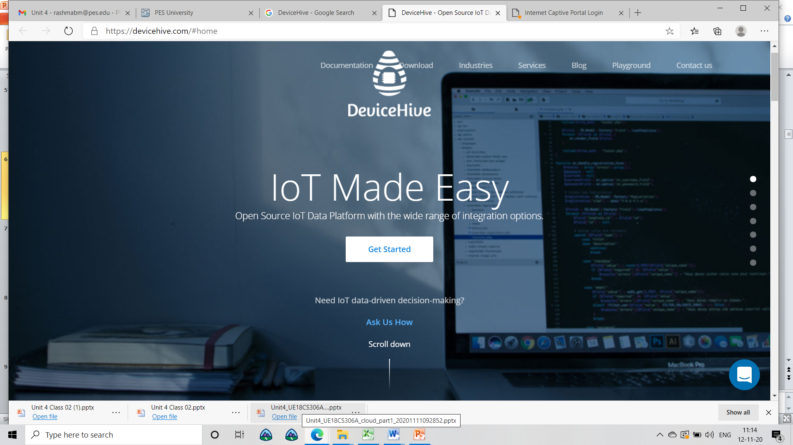
Designing of IoT Solution
Software & Management Tools for IoT

Slide 7
Designing of IoT Solution
Software & Management Tools for IoT
Kaa
Kaa is backed by Cybervision.
Middleware allows developers to create IoT solutions
Easy set up and offers many features.
‘Hardware agnostic’.

Slide 8
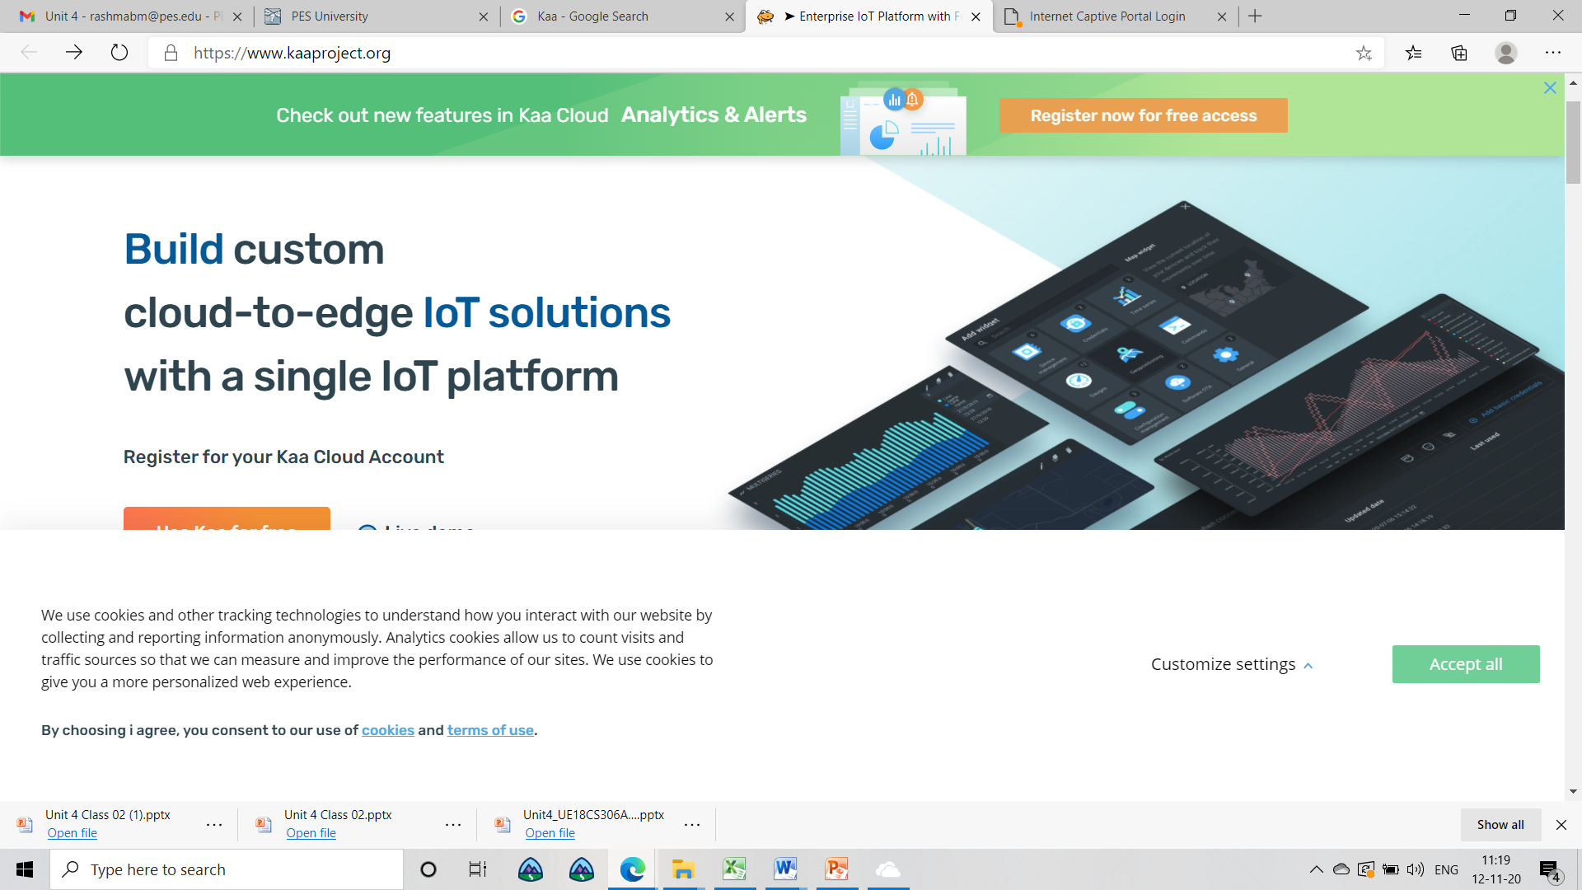
Designing of IoT Solution
Software & Management Tools for IoT
Kaa
Kaa is backed by Cybervision.
Middleware allows developers to create IoT solutions
Easy set up and offers many features.
‘Hardware agnostic’.

Slide 9
Designing of IoT Solution
Software & Management Tools for IoT
Arduino
It offers both hardware and software.
Consists of an MQTT broker which enables developers to send messages from one board to another.
MQTT protocol
Projects that have been created using Arduino include a location tracking
GitHub onto paper.

Slide 10
Designing of IoT Solution
Software & Management Tools for IoT
Home Assistant
Home automation and operates on a Python based coding
Easy to setup and has been noted for its security and privacy capabilities.
Updated regularly every two weeks, and currently supports almost 250 smart devices.
Can also run Python 3

Slide 11
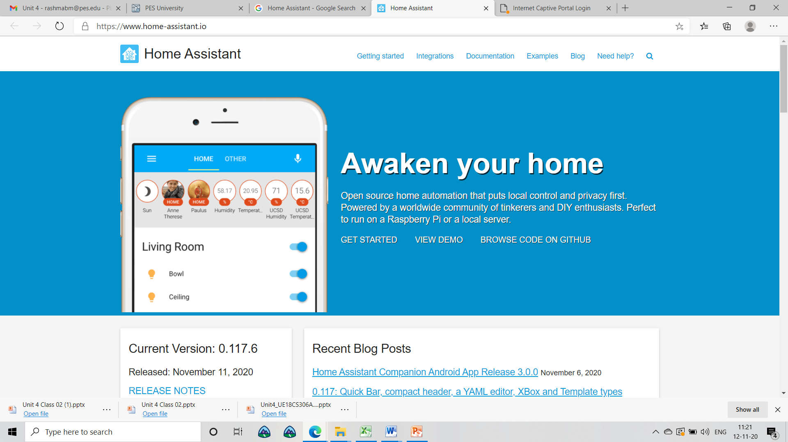
Designing of IoT Solution
Software & Management Tools for IoT
Home Assistant
Home automation and operates on a Python based coding
Easy to setup and has been noted for its security and privacy capabilities.
Updated regularly every two weeks, and currently supports almost 250 smart devices.
Can also run Python 3

Slide 12
Designing of IoT Solution
Software & Management Tools for IoT
Devicehub.net
Integrated solution for IoT project development.
‘Paas’ with which both hardware and mobile developers
Enabled rapid development of fleet management systems, intelligent vending machines.
Friendly it is with entrepreneurial parties.

Slide 13
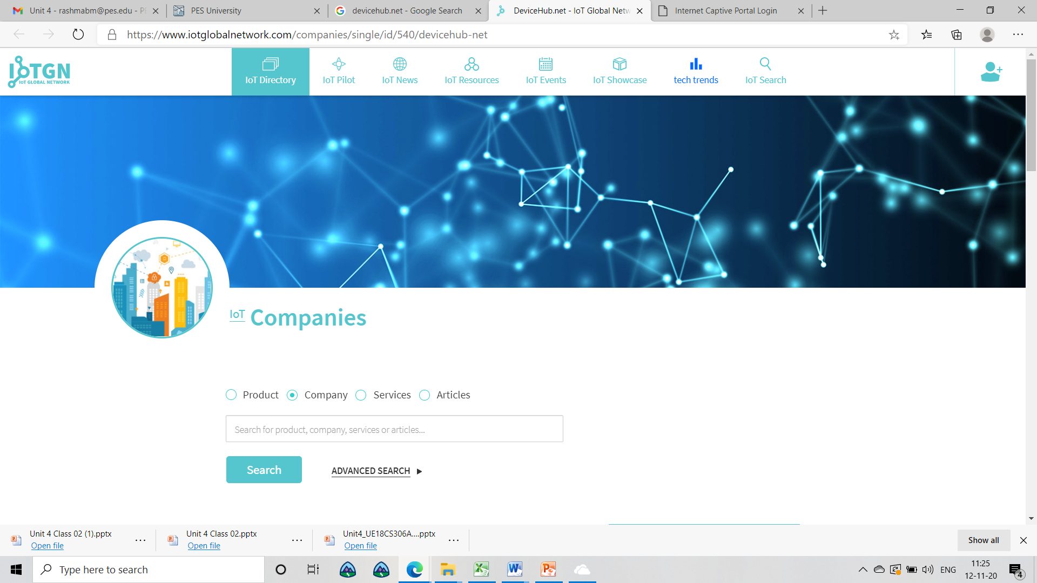
Designing of IoT Solution
Software & Management Tools for IoT
Devicehub.net
Integrated solution for IoT project development.
‘Paas’ with which both hardware and mobile developers
Enabled rapid development of fleet management systems, intelligent vending machines.
Friendly it is with entrepreneurial parties.

Slide 14
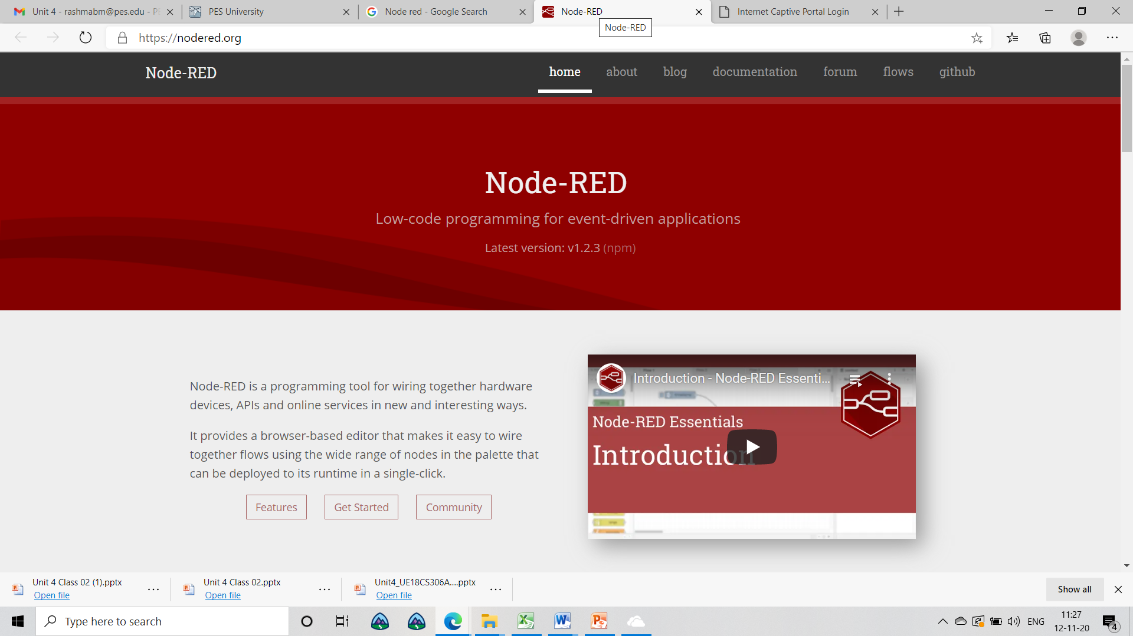
Designing of IoT Solution
Software & Management Tools for IoT
Node-Red
Node-Red is a visual tool for lining the Internet of Things, i.e., wiring together hardware devices
Node.js, Node-RED describes itself as “a visual means for wiring the Internet of Things”.
Developers to connect devices, services, and APIs using a browser-based flow editor
Run on Raspberry Pi, Asynchronous IO
Single-Threaded event queue. Runs on Javascript

Slide 15
Designing of IoT Solution
Software & Management Tools for IoT
Node-Red
Provides a browser-based drag-drop UI for creating flows.
The light-weight runtime, built in node.js.
Easily expanded to take add new nodes to the palette, package manager (npm)
Developed by IBM
The default port is 1880

Slide 16
Designing of IoT Solution
Node Red
Where the Application works
Some data from something that is hard to classify?
Send the logs off to this other server, Add some additional REST endpoints
Why Node-RED?
Does not have a one-size-fits-all solution
Every new “thing” has a new API Solutions
Access a serial port, or complete an OAuth flow

Slide 17
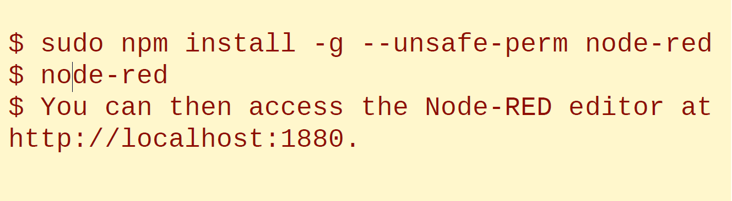
Designing of IoT Solution
How to install Node-Red
Ubuntu
Note:- node-red –s mysettings.js –p 1889

Slide 18
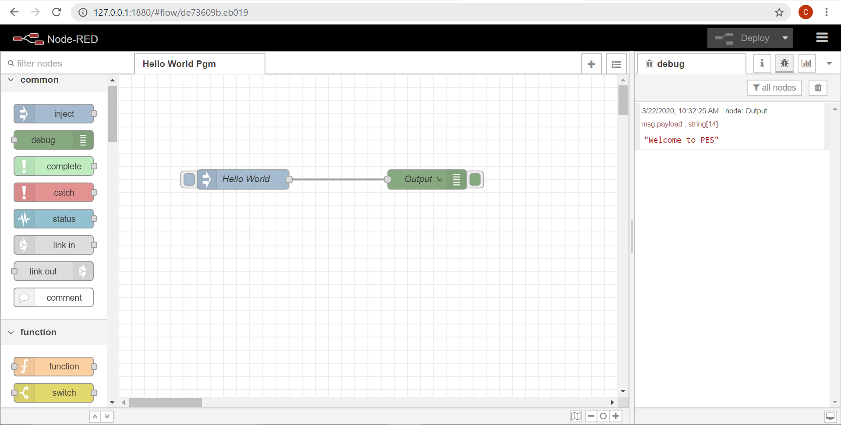
Designing of IoT Solution
Node-Red GUI

Slide 19
Designing of IoT Solution
Node-RED is
An application composition tool, Lightweight POC, Easy to use
Add new capabilities and Creating the back-end glue
A great way to try…
“can I just get this data from here to there?”
“and maybe change it just slightly along the way…”
Deployed in a manufacturing production line, Required extra sensors.
Raspberry Pi’s + Arduinos + Sensors and coordinated via Node-RED
Able to adapt and change quickly, The default settings file in Node-Red is settings.js

Slide 20
Designing of IoT Solution
Architecture of Node-RED
Node.js v8-engine driven
Event-driven, asynchronous io
Single-threaded event-queue
Javascript front and back
Built using express, d3

Slide 21
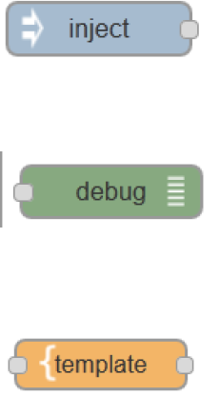
Designing of IoT Solution
Basic Node types

Slide 22
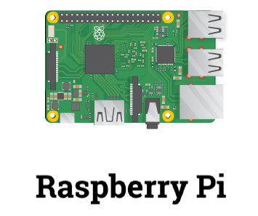
Designing of IoT Solution
Raspberry Pi

Slide 23
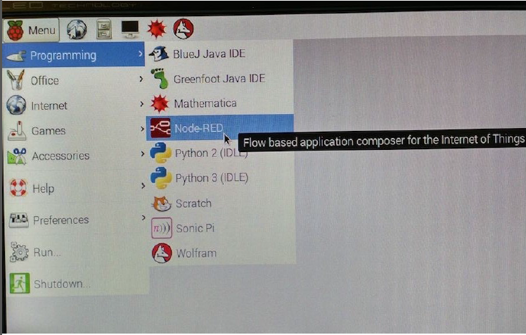
Designing of IoT Solution
Pre-installed on Raspberry Pi

Slide 24
Hello world
Msg.payload

Slide 25
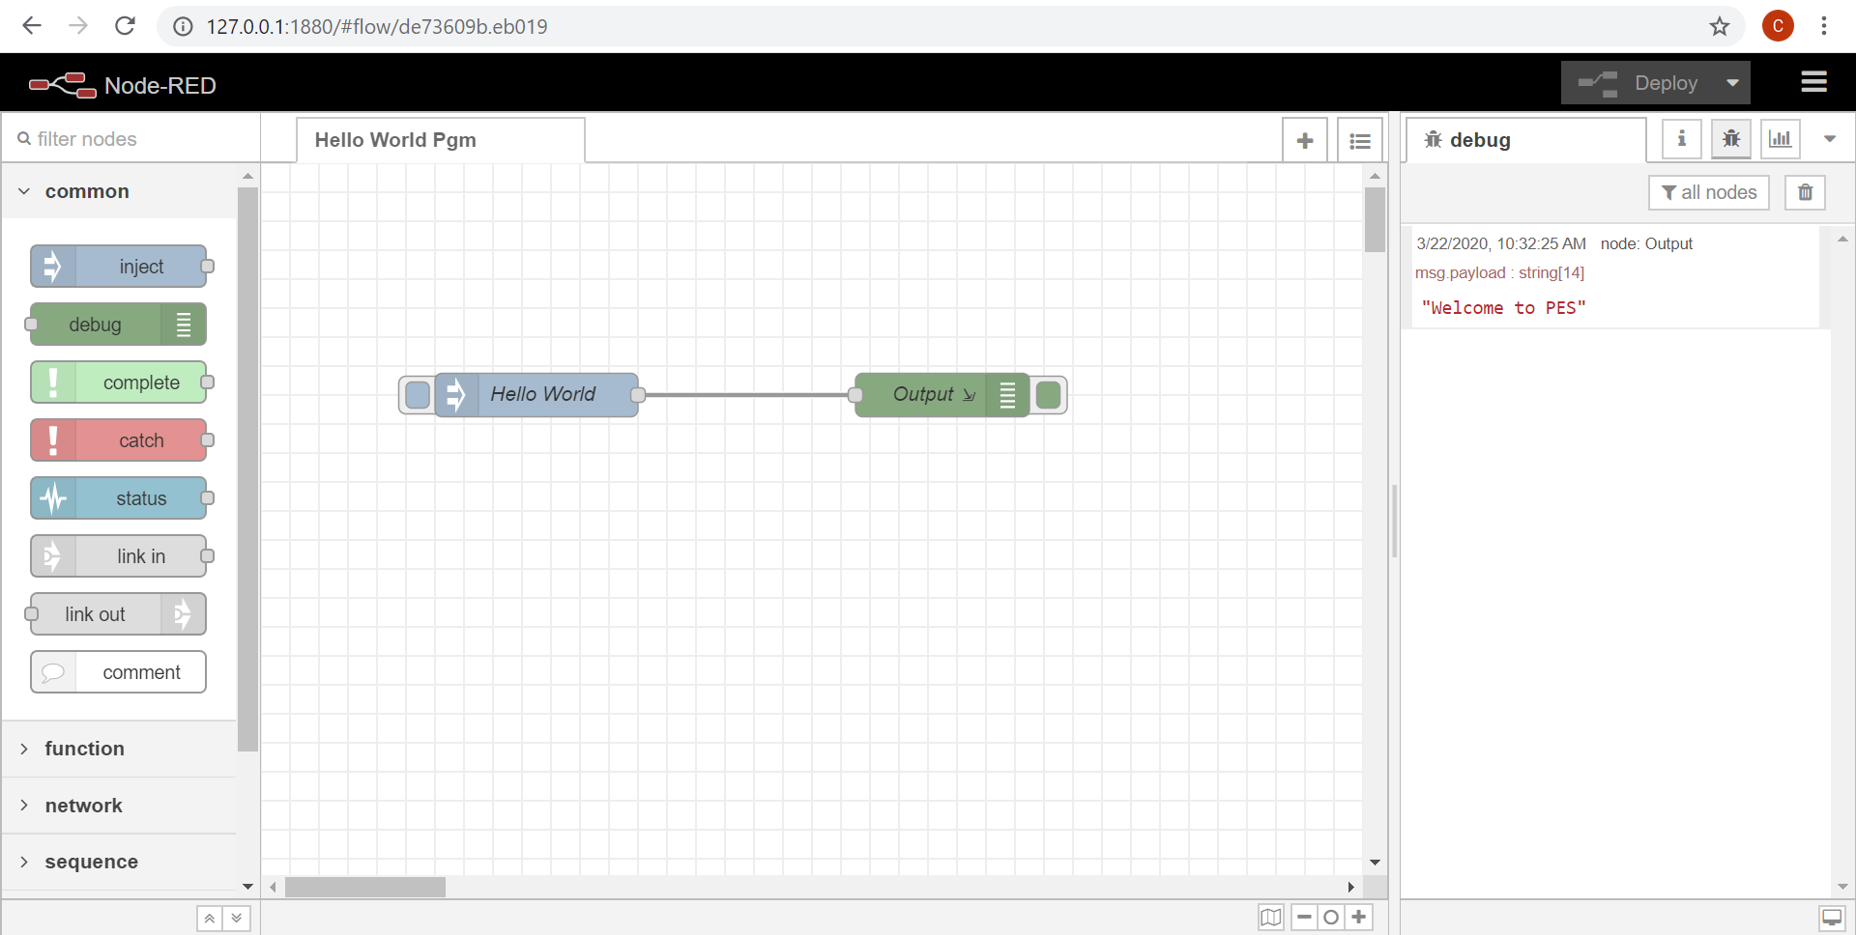
Designing of IoT Solution
Node-Red Hello World Program

Slide 26
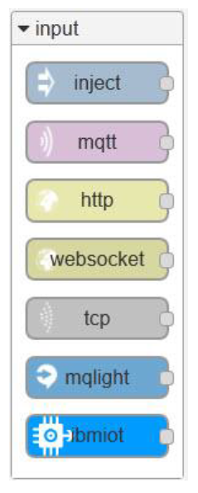
Designing of IoT Solution
Input Nodes

Slide 27
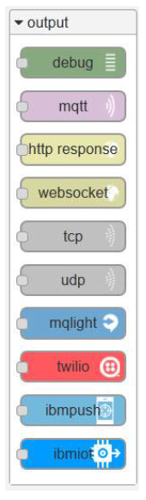
Designing of IoT Solution
Output Nodes

Slide 28
Designing of IoT Solution
Function Node Types
Function node
User-defined node.js code on the messages going by Uses vm.createScript
Switch
Change flow to different

Slide 29
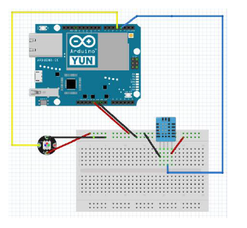
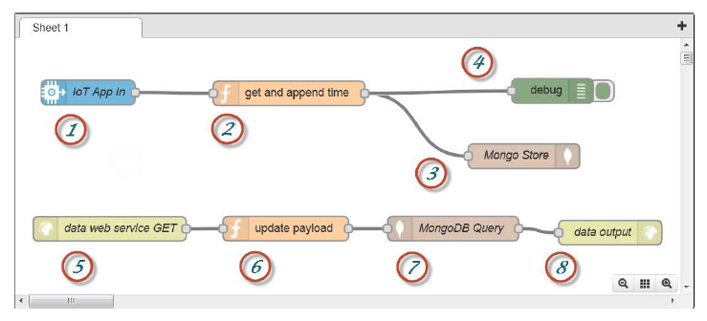
Designing of IoT Solution
Temperature Sensor Example

Slide 30
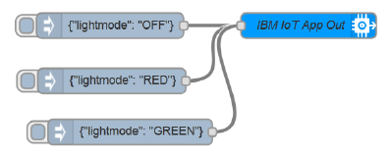
Designing of IoT Solution
Making actions happen – sending events

Slide 31
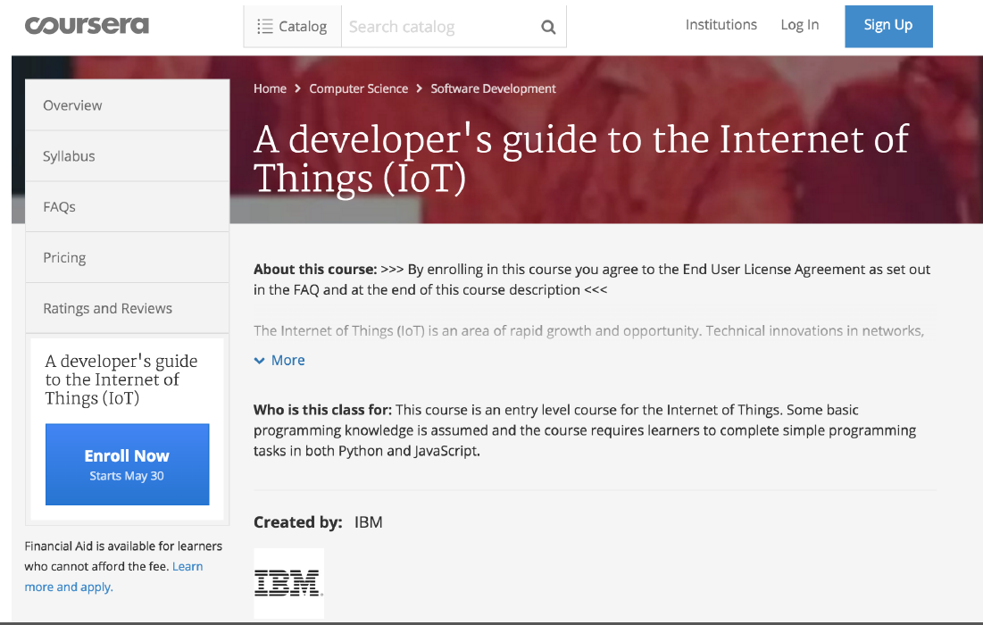
Designing of IoT Solution
Coursera – A developer’s guide to the Internet of Things

Slide 32
Designing of IoT Solution
Sources for Hardware and Examples
Arduino Yun – available from Amazon or Radio Shack
DHT11 and NeoPixel – available from Adafruit (www.adafruit.com)
Nick O’Leary’s MQTT Library for Arduino
http://knolleary.net/arduino-client-for-mqtt/
IBM IOT Foundation - https://internetofthings.ibmcloud.com/#/
IBM Bluemix – http://www.bluemix.net
JazzHub link to download examples
https://hub.jazz.net/git/brownkyl/arduinoyun
Original four-part DeveloperWorks series
http://www.ibm.com/developerworks/cloud/library/cl-bluemix-arduino-iot1/index.html

Slide 33
THANK YOU
Charanraj B R
Department of Computer Science Engineering
charanarajbr@pes.edu
+91 80 6666 3333 Extn 721

